Slide 1

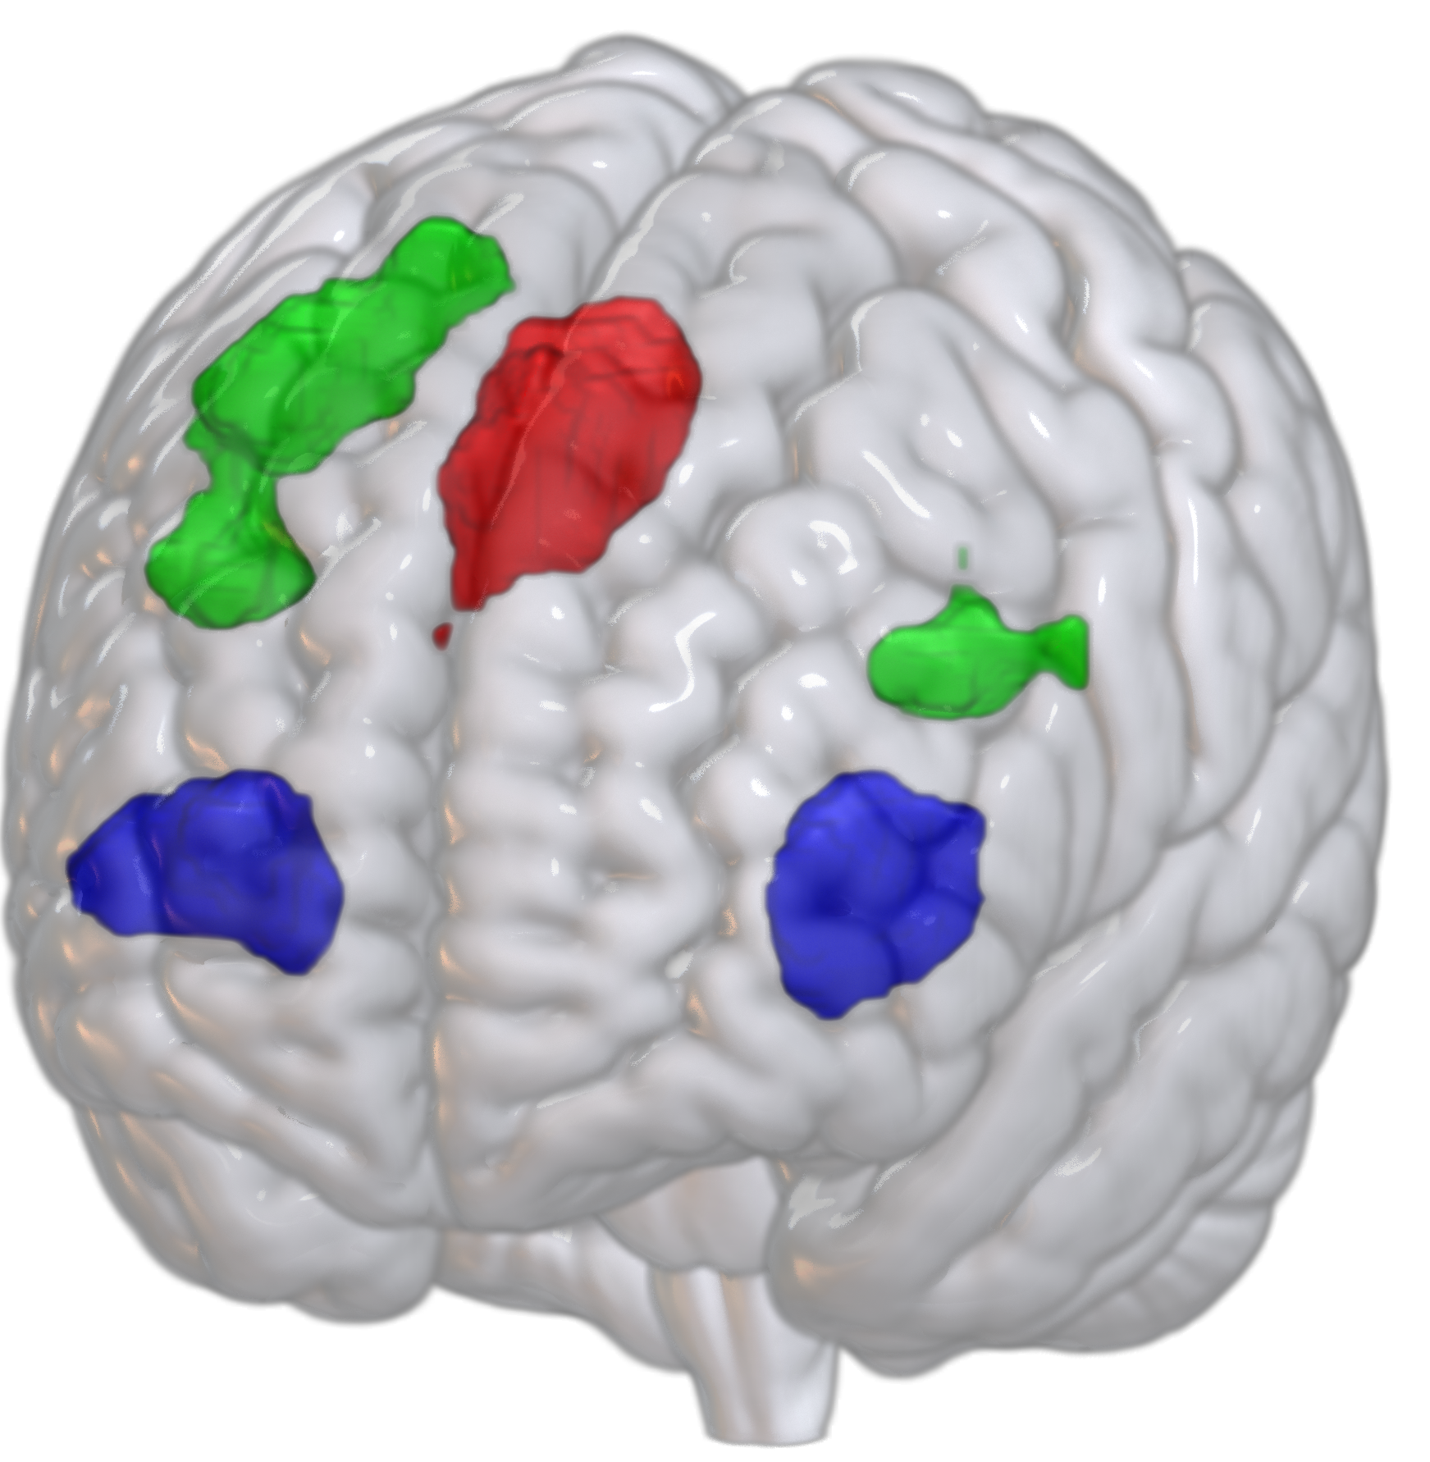
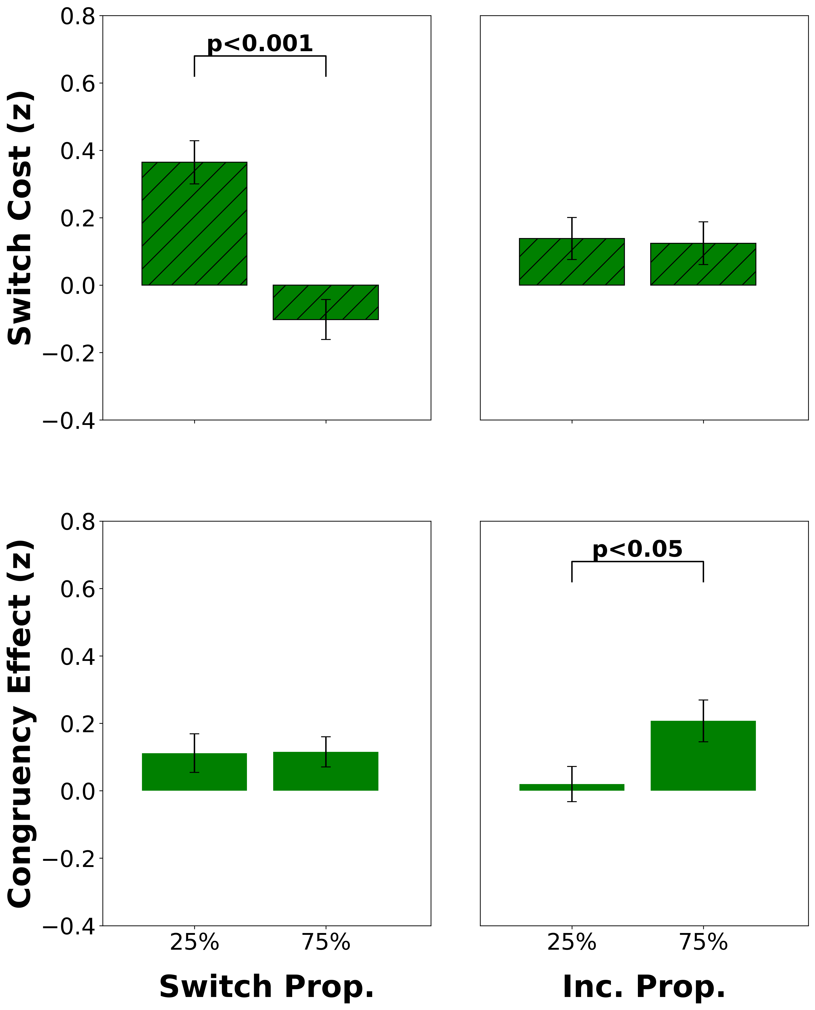
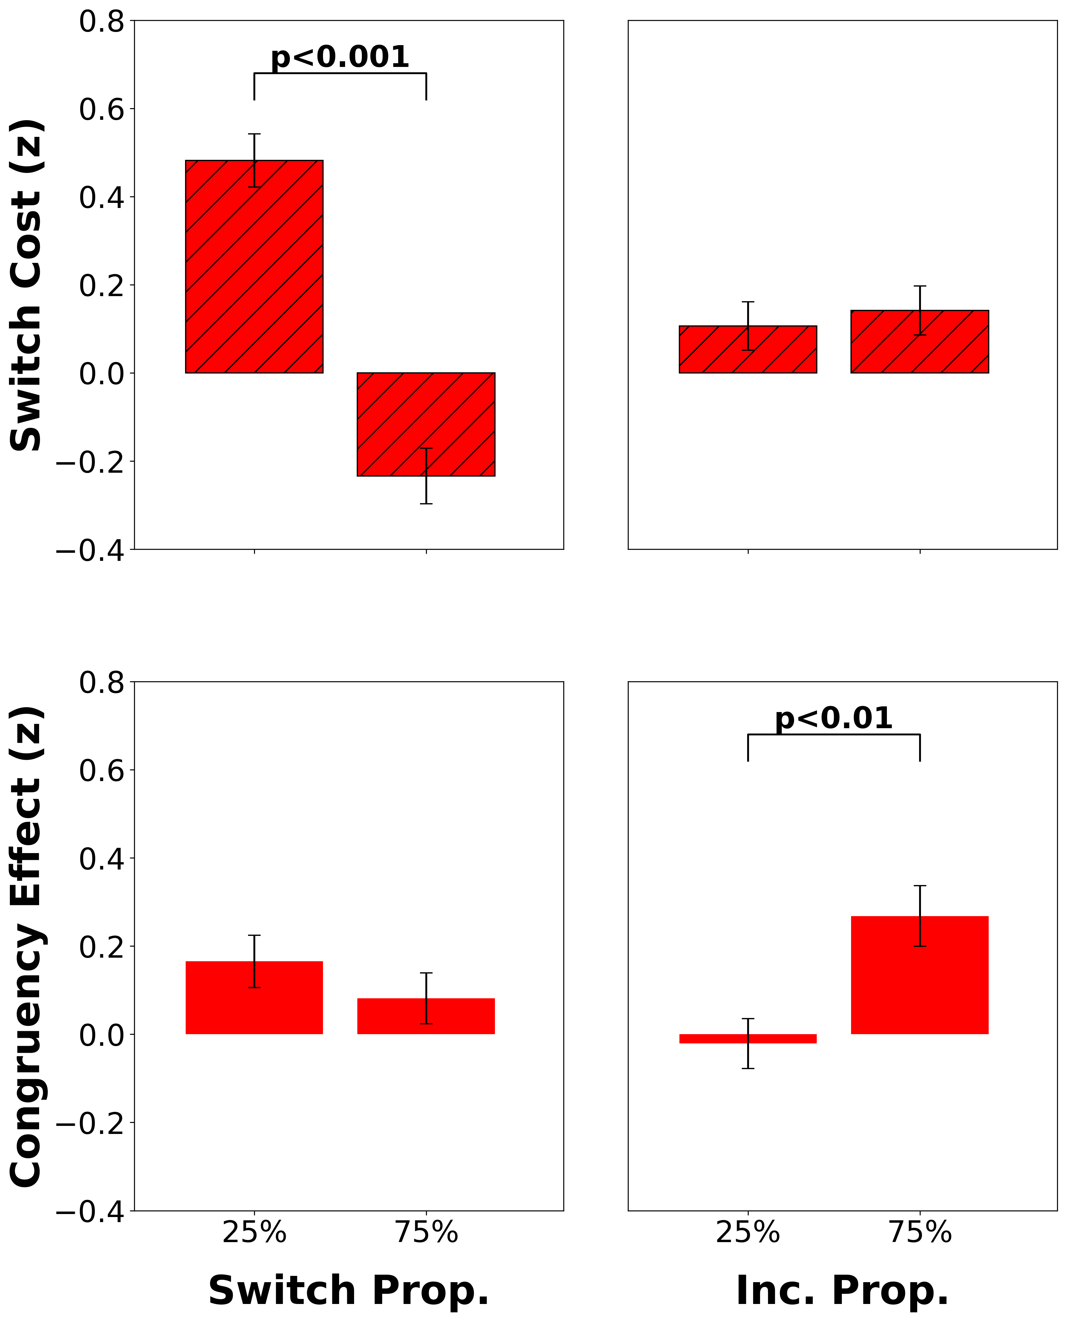
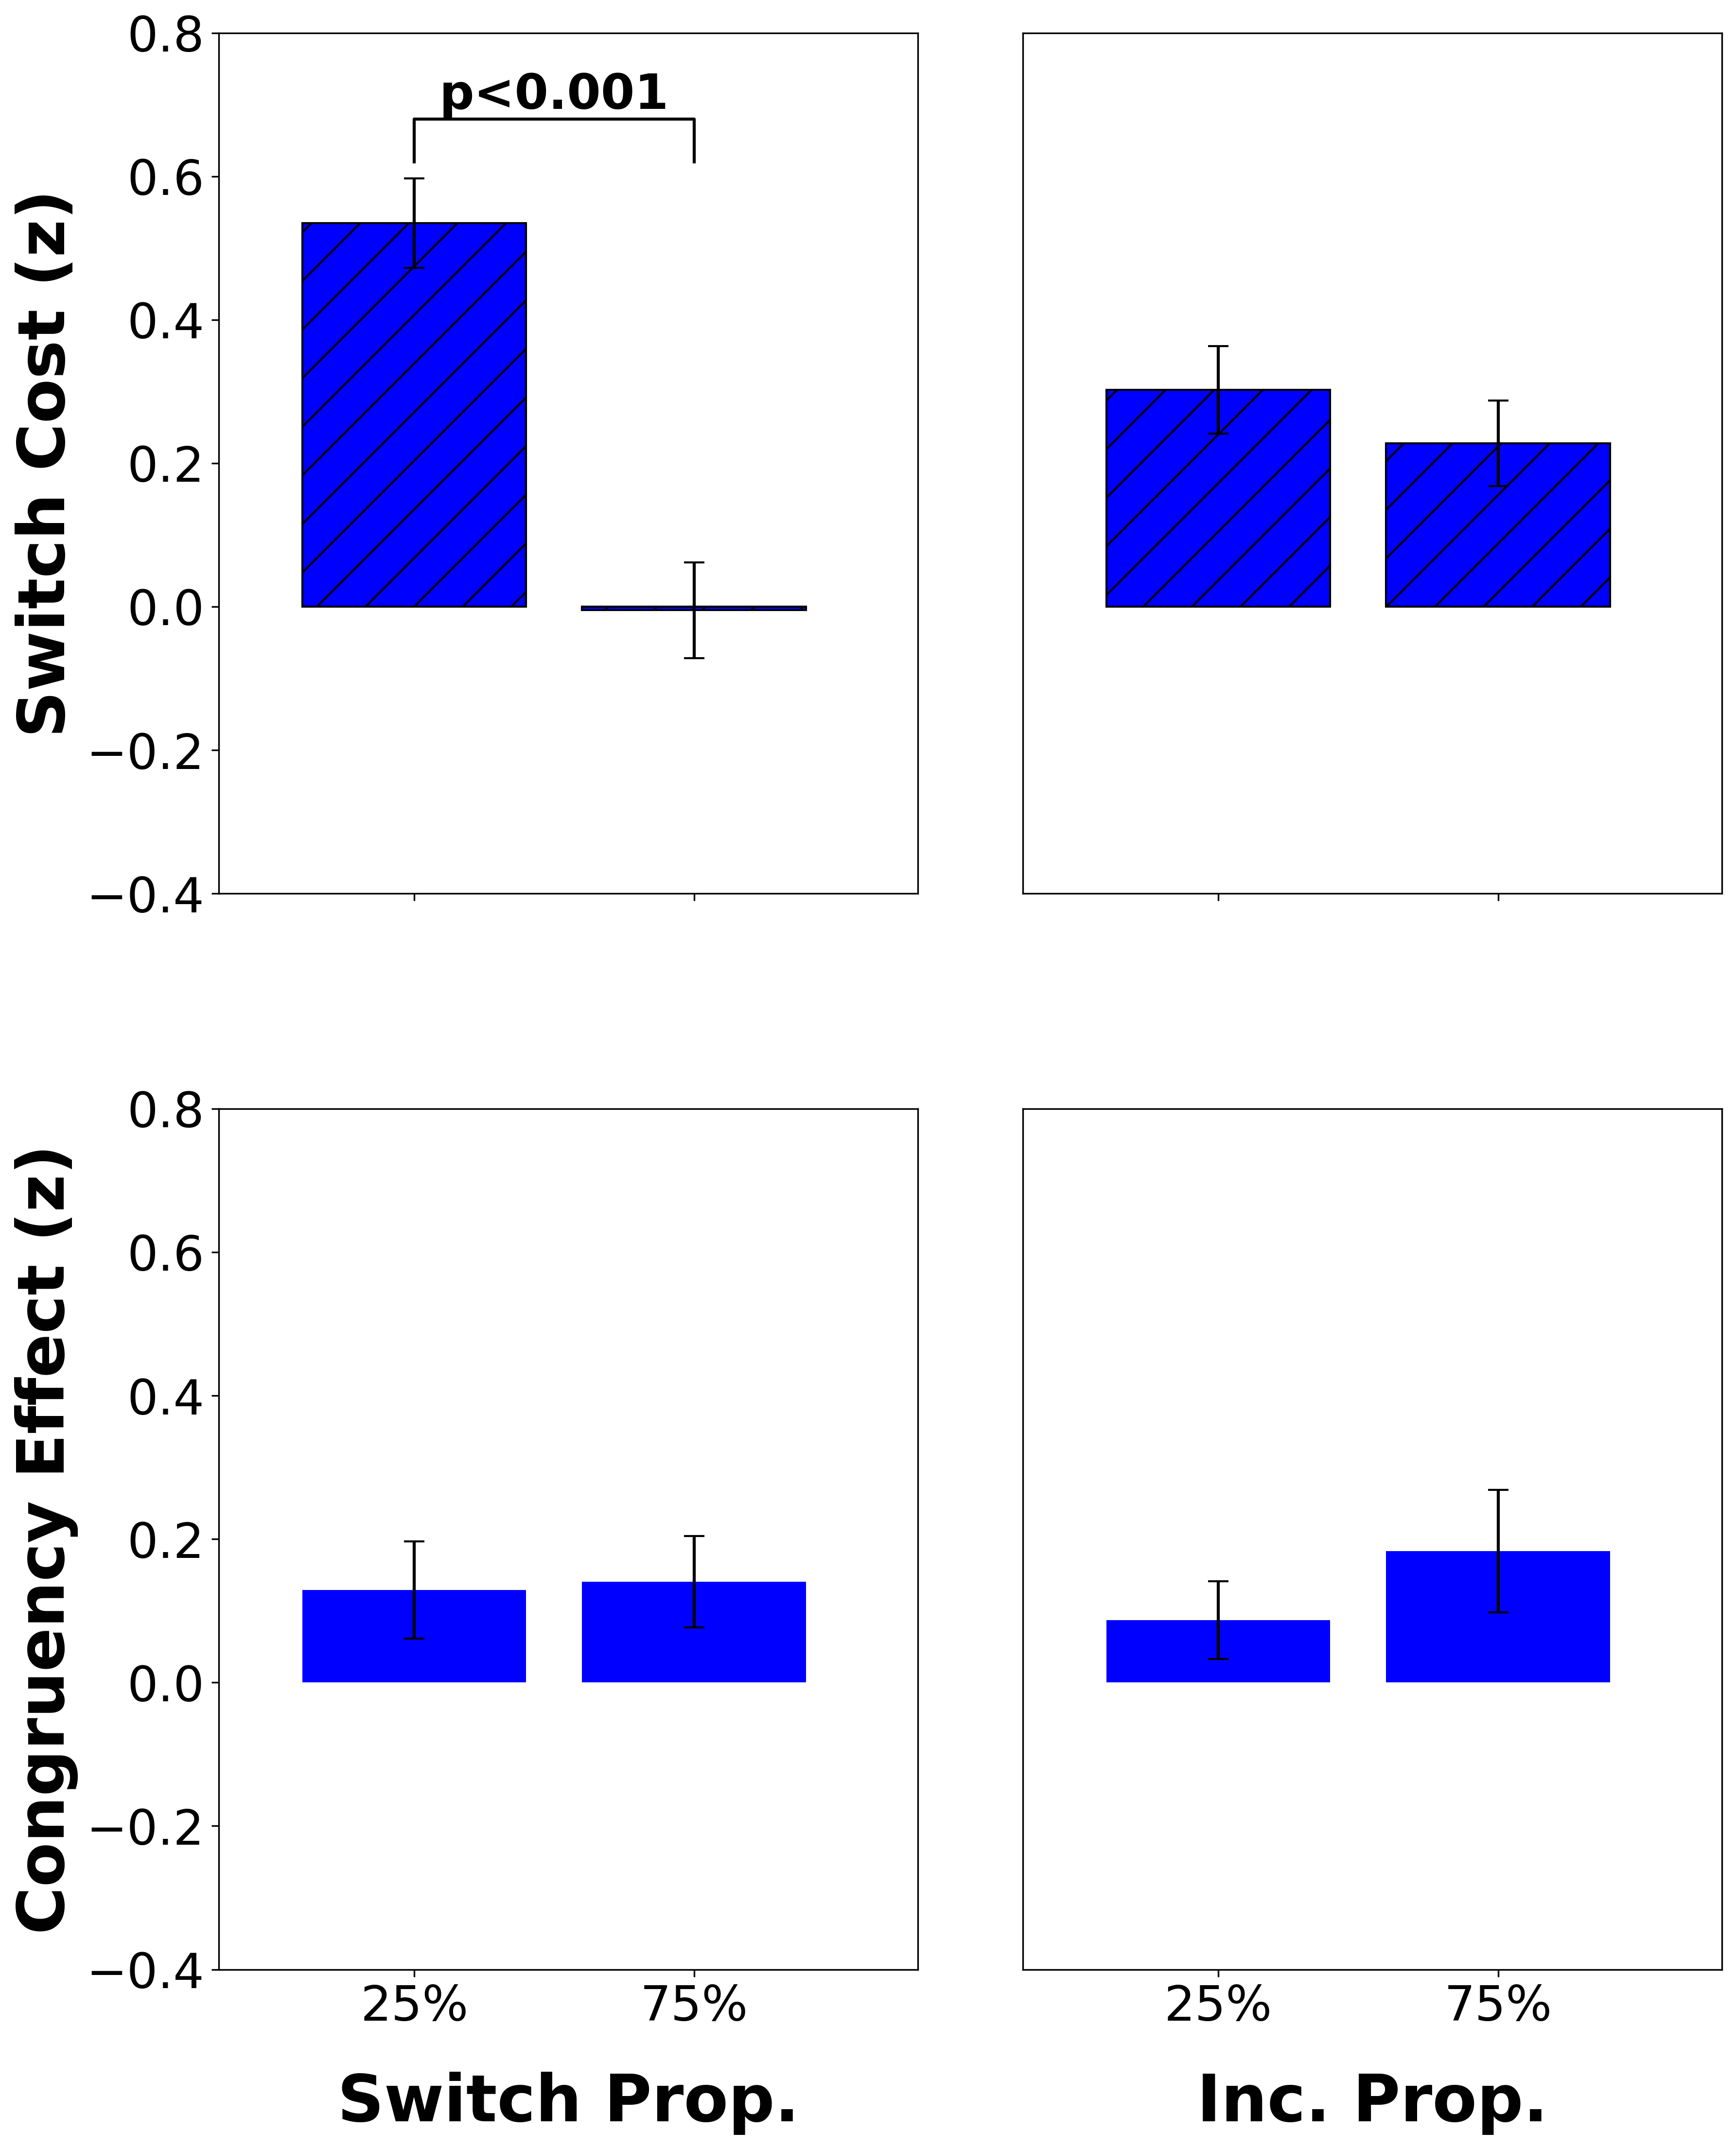
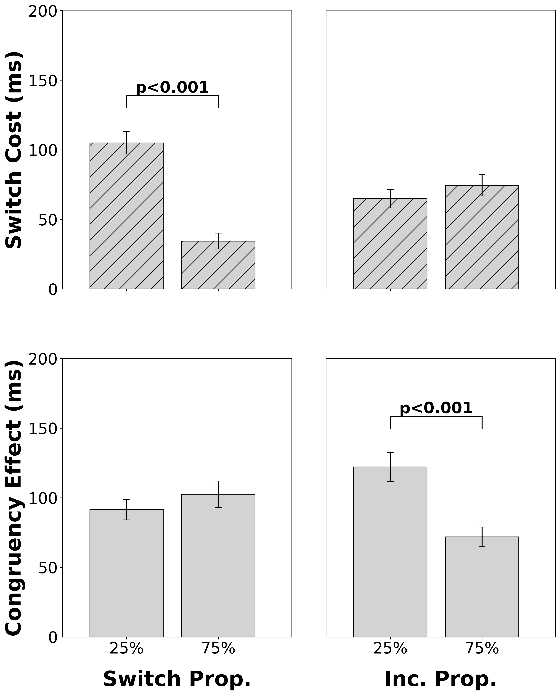
Intracranial EEG Correlates of Concurrent Demands on Cognitive Stability and Flexibility
Neural Correlates of Concurrent Demands on Cognitive
Stability and Flexibility
Jinjiang Zhang^{1,2}, Raphael Geddert^{1,2}, Roshni Ammanamanchi^{1,2}, Andrew Michael², Tobias Egner
Department of Psychology and Neuroscience¹, Center for Cognitive Neuroscience²
Duke University
Background
LWPS Significant Clusters (Title???)
Cognitive stability (task focus) and flexibility (task switching) are two core capacities of cognitive control, yet their relationship and neural substrates are unclear^{1,2}
Previous studies have separately shown activation for stability and flexibility in lateral and medial frontal cortex^{3,4}, but whether they have distinct or shared neural substrates is still not known
Do cognitive stability and flexibility have distinct or shared neural substrates?
Put the fmri methods here – maybe put these methods under study design, then put behavioral results up here? And figure out how to organize the neural results – I think left, middle, right. But then where to put behavior? Ask Jackie..
Draw arrows from brain regions to their bar plots
Study Design
dlPFC independently adjusts stability and flexibility
ACC independently adjusts stability and flexibility
Participants completed a classic cued task switching experiment (n=45)
Repeat
Switch
2
7
1
…
Odd or Even
< 5 or > 5
Switch costs index flexibility (RT_{switch} – RT_{repeat})
Congruency effects index stability (RT_{inc} – RT_{con})
.
vlPFC adjusts flexibility
Congruent
Incongruent
👈🏽
< 5
even
> 5
odd
👉🏽
👈🏽
< 5
even
> 5
odd
👉🏽
The proportion of incongruent and switch trials varied independently across block types (2 blocks per functional run, 4 runs total)
75%
Block A
64 Trials
Block B
64 Trials
Switch proportion
25%
Block C
64 Trials
Block D
64 Trials
25%
75%
Incongruent Proportion
Behavioral Results
Switch proportion modulates switch cost
Discussion
References/Acknowledgments
Something about how lwps sensitive areas have their activity independently adjusted for stability and flexibility
Future work will also investigate the temporal differences between conditions
1. Egner 2023, Nat Rev Psychol. 2. Geddert and Egner 2022, Journal of Experimental Psychology. 3. Worringer et al. 2019, Brain Struct Funct. 4. Wu et al. 2020, J Comp Neurol. Thanks to all members of the Egner lab for their guidance and support on this project
This work was funded by NIH Grant RO1 MH133550
Incongruent proportion modulates congruency effect
CONTACT
jim.zhang@duke.edu
CONTACT
jim.zhang@duke.edu

